Slide 1
SOEN-6011
PROJECT ETERNITY
DELIVERABLE - 2
JAIWANT SINGH MAHUN
40270569
Wednesday, July 24, 2024

Slide 2

Transcendental Function
F4 (Gamma Function) : Γ(x)
DEFINITION
A gamma function, represented by Γ(x) , is an extension of factorial function to non integers and complex numbers. It can be represented in 2 ways :
For positive integers, it can be represented as :
Γ(z) = (z-1)! for z ∈ Z+
For any real number > 0, gamma function can be represented as:
where, z is a complex number and real part is strictly positive (Re(z)>0)
PG 2.

Slide 3
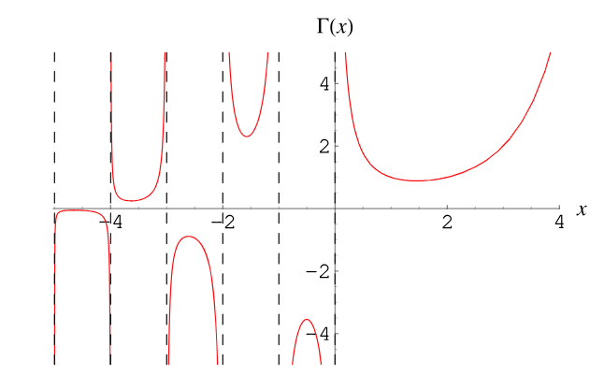
Domain
Γ(z) is defined for all complex number z where, z is not a non-positive integer.
Co-Domain
Γ(z) function can produce all complex numbers except non-positive integers, where function is non defined.
Plot Representation
PG 3.
[1] Plot of Gamma function

Slide 4
ASSUMPTIONS
Assumes that computational libraries/ programming languages will be able to support very large values along with high precision.
Eg : BigDecimal in Java.
Assume that application is using Java swing for GUI.
Assumes application is runnable on any system with JAVA.
For practical computations, certain approximations or rounding offs can be made for tradeoffs between computation speed and precision.
Gamma function is continuous and differentiable for positive real numbers.
PG 4.

Slide 5
REQUIREMENTS
FUNCTIONAL REQUIREMENTS :
ID : GAMMA-REQ-001
Title : Function Equation
Description : Γ(z) must satisfy : Γ(z) = (z-1) Γ(z-1) for Re(z)>0
Stakeholder Priority : High
Rationale : The equation is recursive property of Gamma functions
Difficulty : Nominal
Type : Functional
Assumption : z is a positive real number.
ID : GAMMA-REQ-002
Title : Function Equation for positive integers
Description : For any positive integer z, Γ(z) shall satisfy : Γ(z) = (z-1)! , z ∈ Z+
Stakeholder Priority : High
Rationale : Ensures function is consistent for positive integers.
Difficulty : Nominal
Type : Functional
Assumption : z is a positive integer.
PG 5.

Slide 6

ID : GAMMA-REQ-003
Title : Euler Infinite Product
Description : For any real number z except non positive integers,
Γ(z) satisfies :
Stakeholder Priority : Medium
Rationale : Efficient estimate of complex number z including
negative real numbers except non positive integers.
Difficulty : Nominal
Type : Functional
Assumption: For practical computation, n is taken as a large no. (80k)
PG 6.

Slide 7
II. NON-FUNCTIONAL REQUIREMENTS :
ID : GAMMA-REQ-004
Title : Usability
Description : User Interface of application should be easy to use and navigate.
Rationale : The application’s GUI should be easy to use
Type : Non-Functional
Assumption : GUI is runnable as java application on any system which has java.
ID : GAMMA-REQ-005
Title : Reliability
Description : The application must handle invalid input values.
Rationale : The application’s GUI should be easy to use
Type : Non-Functional
Assumption : GUI is runnable as java application on any system which has java.
ID : GAMMA-REQ-006
Title : Computation Efficiency
Description : For computational efficiency, the results computation is fast and precise.
Rationale : Efficient computation of gamma value.
Type : Non-Functional
Pg 7.

Slide 8
III. TECHNICAL REQUIREMENTS :
ID : GAMMA-REQ-007
Title : Exception Handling
Description : The application should implement Exception handling mechanism
for runtime errors.
Rationale : Error Handling mechanism for GUI application
Type : Technical
ID : GAMMA-REQ-008
Title : GUI Technical Stack
Description : The GUI should use JAVA Swing and app is Platform Independent.
Rationale : The application’s GUI should run on Java Swing and app can run on any system
with java in it.
Type : Technical
ID : GAMMA-REQ-009
Title : Power method computation
Description : Replace in built-in Power method by:
x^(n + fractionalPart) = x^n * x^(fractionalPart)
Rationale : The application should not use any in built function.
Type : Technical
PG 7.

Slide 9
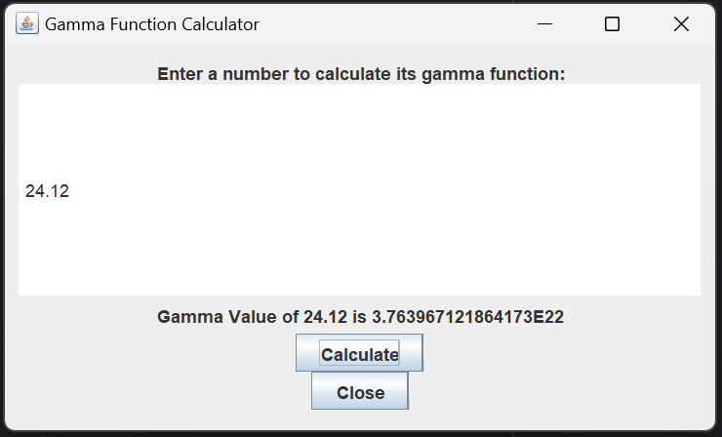
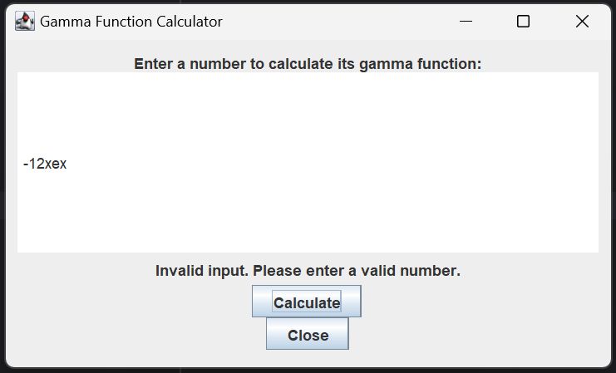
IMPLEMENTATION
GUI :
CORRECT INPUT
INCORRECT INPUT
Github Link : https://github.com/JSM2512/soen6011
Pg 8.

Slide 10
REFERENCES
[1] https://mathworld.wolfram.com/GammaFunction.html
[2] https://en.wikipedia.org/wiki/Gamma_function
[3]https://math.libretexts.org/Bookshelves/Analysis/Complex_Variables_with_Applications_(Orloff)/14%3A_Analytic_Continuation_and_the_Gamma_Function/14.02%3A_Definition_and_properties_of_the_Gamma_function
[4]https://en.wikipedia.org/wiki/Stirling%27s_approximation
[5]https://www.roma1.infn.it/~bonvini/math/Marco_Bonvini__Gamma_function.pdf
[6]https://chatgpt.com/
[7]https://www.javatpoint.com/javafx-tutorial
PG 9.

